Slide 1
INC 5000 COMPANIES (2019) DATA ANALYSIS
- Hafsha Wahab

Slide 2
Inc 5000 Ranking
The Inc. 5000 lists the 5,000 fastest-growing private companies in the United States.
The list has been created by Inc. magazine every year since 1982. Inc. 5000 list honors corporate growth, innovation, and achievement.
The list represents companies that have driven rapid revenue growth while navigating inflationary pressure, the rising costs of capital, and seemingly intractable hiring challenges.

Slide 3
Background
A dataset containing information about each company on the INC 5000 list in 2019.
Fields include the company name, industry, founding year, website, and location, as well as 2019 revenue, % growth, number of workers (year-over-year), and the number of years on the list.
We have been provided with some recommended questions to analyze.
The complete analysis is performed using MS Excel and Tableau.
Data Source:
https://www.kaggle.com/datasets/mysarahmadbhat/inc-5000-companies

Slide 4
Methodology
Phase 5
Phase 4
Data Interpretation
Phase 3
Data Analysis
Phase 2
Data Modeling on Tableau Public
Phase 1
Data Cleaning & organisation
Data Collection from Kaggle

Slide 5
Understanding the KPIs
Average Revenue
Growth Rate
Employment
Regions
Top industries
Increment/ decrement
Geographic Trends
Generated by industries

Slide 6
Financial Analysis
# of States
52
Average Growth %
455
# of Companies
5012
Total Revenue
238 billions

Slide 7
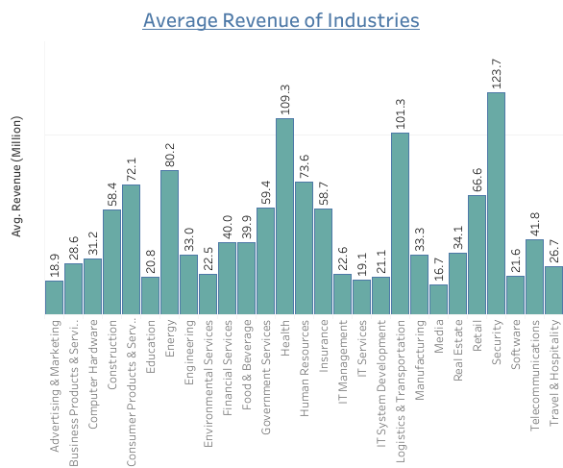
Data Analysis
1) What is the average revenue among companies on the list?

Slide 8
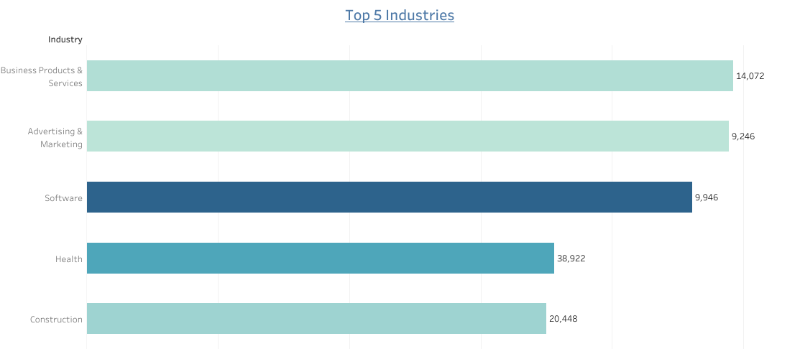
2 a) Which industries are most represented in the list?

Slide 9
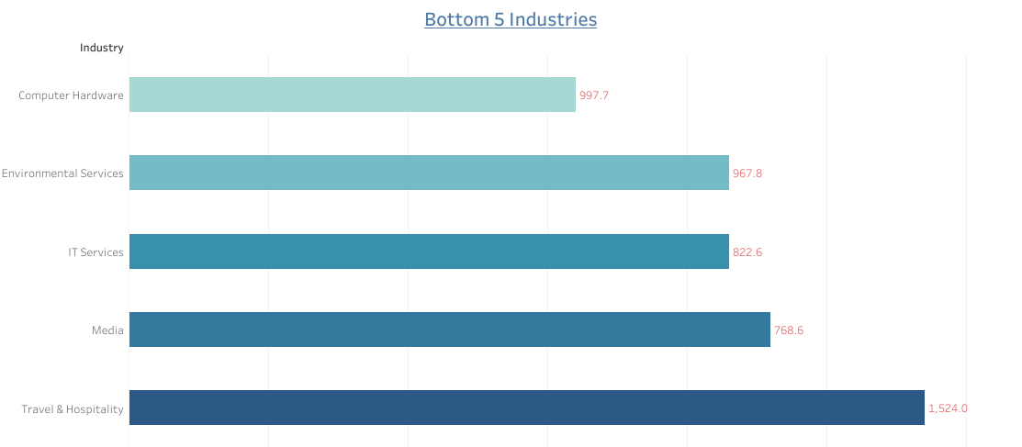
2 b) Which industries are least represented in the list?

Slide 10
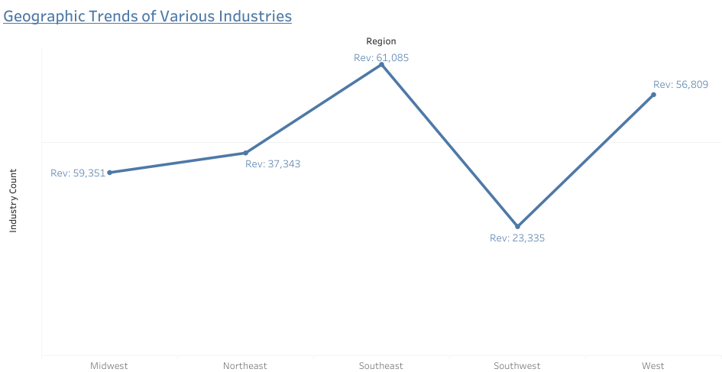
3) Are there any interesting geographic trends?

Slide 11
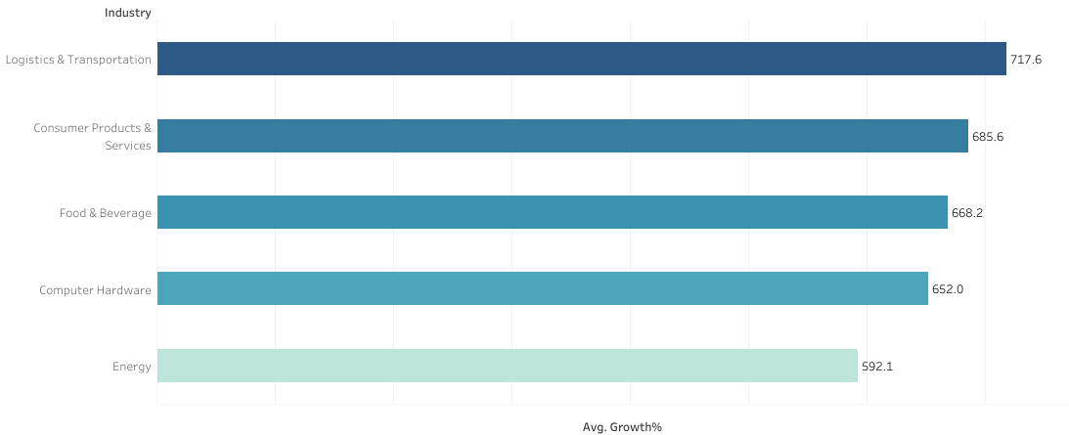
4) Which industries saw the largest average growth rate?

Slide 12
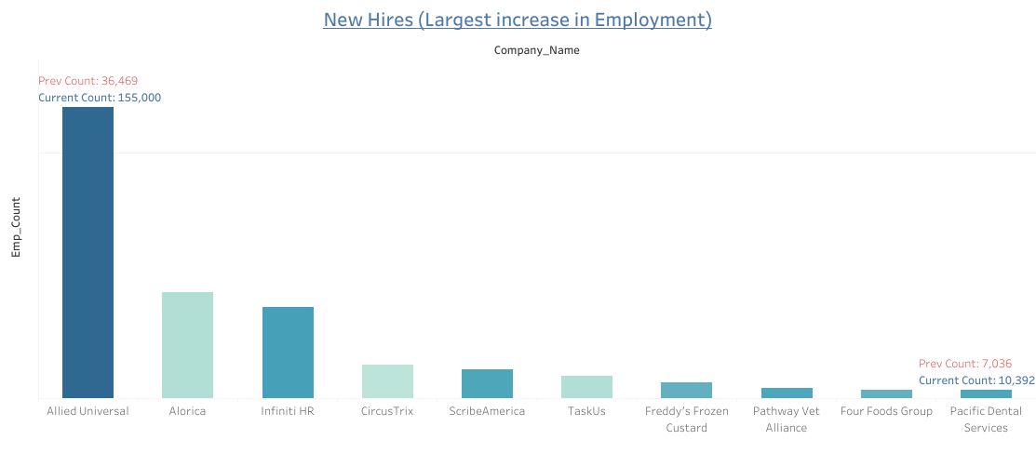
5 a) Which companies had the largest increase in staff/new hires? (Top 5 Companies)

Slide 13
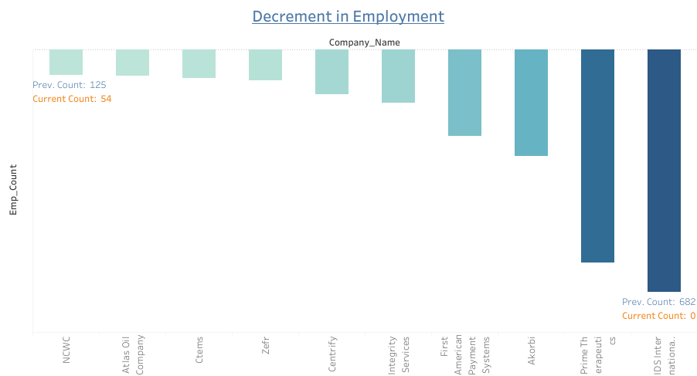
5 b) Which companies had the largest increase in staff/new hires? (Bottom 5 Companies)

Slide 14
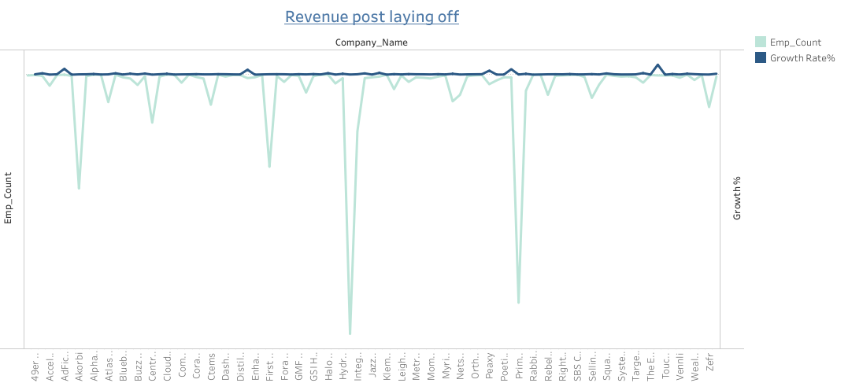
6) Did any company increase revenue while reducing staff?
Tier 4 Group
Growth rate: 10.33%

Slide 15
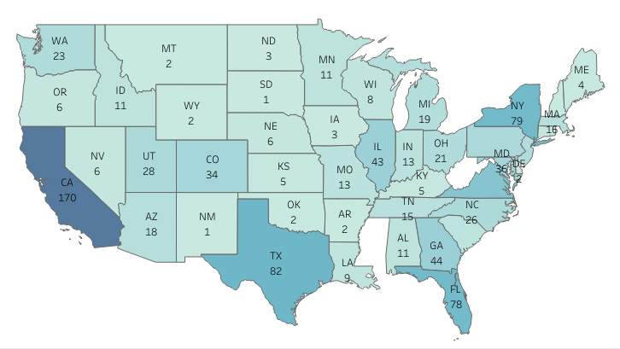
7) Top 1000 - Winner State (The most frequent state appearing in the Top 1000 values of companies)

Slide 16
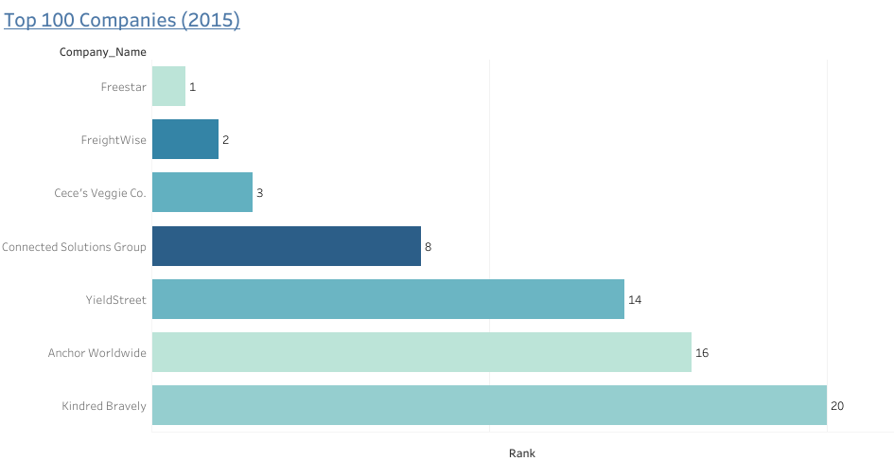
8) Do we have any company which was founded last year and ranked under Top 100?
In total there are 131 companies founded in 2015. Out of these, 24 companies are ranked in top 100.

Slide 17
Conclusion
There are 3 top industries Security , Health, and Logistics & Transportations generating average revenue 123.7, 109.3 and 101.3 millions respectively.
Most represented industries are Business Products & Services, Advertisement & Marketing & Software.
Southeast region is leading in having the top 3 industries in its region.
Security industry has the largest average growth rate.
Allied Universal has shown the highest increase in employment.

Slide 18
Conclusion
Tier 4 Group has seen 10.33% increase in growth rate after laying off the employees.
California, New York and Texas are the top 3 states which have positioned top 1000 ranking.
Since the Inc 5000 ranking is done based on 3 years' performance, our analysis found that in the year 2015, there were 131 companies founded and surprisingly there were 24 companies in the top 100. We also found that Freestar (an advertisement & Marketing company) was not only in the top 100 but also 1st position in the Inc 5000 ranking for the year 2019.

Slide 19
Suggestions to Clients
Clients should explore to build their business in the fields of Security, the Health sector, and Software technologies.
Southeast and West regions are the hubs for business growth, one could explore these areas.
To view full visualizations click below:
https://public.tableau.com/views/Inc5000CompaniesDataAnalysis2019/Dashboard12?:language=en-GB&:sid=&:display_count=n&:origin=viz_share_link
https://public.tableau.com/views/Inc5000CompaniesDataAnalysis2019/Dashboard22?:language=en-GB&:sid=&:display_count=n&:origin=viz_share_link

Slide 20

Thank you
For any query connect with me on
linkedin.com/in/hafsha-wahab-767032159/

